Slide 1
CSM 4.1 Iteration 1 Design
Vijay Parmar

Slide 2
CSM 4.1 Iteration 1 requirements
Instance and Attribute Level Security for Groups
Support Hibernate Annotations
Optimize Instance Level security SQL queries for MySQL performance

Slide 3
Requirements explained..
Instance level security for Groups
  From caGrid, the groups will originate from Grid Grouper.
  The client application will have a list of groups on which the instance level security has to be provided.
  If at least one group from the list has access on the instance than access will be provided for the instance.
Attribute Level Security for Groups
  If at least one group from the list has access on the attribute then access will be granted on the attribute.

Slide 4
Requirements explained..
Support for Hibernate Annotations
  Current support of HBM files only.
  New requirement allows various client applications to use Hibernate annotations as well.
MySQL Query performance
  Get with DBA to optimize query performance for Instance Level Security SQL queries.

Slide 5
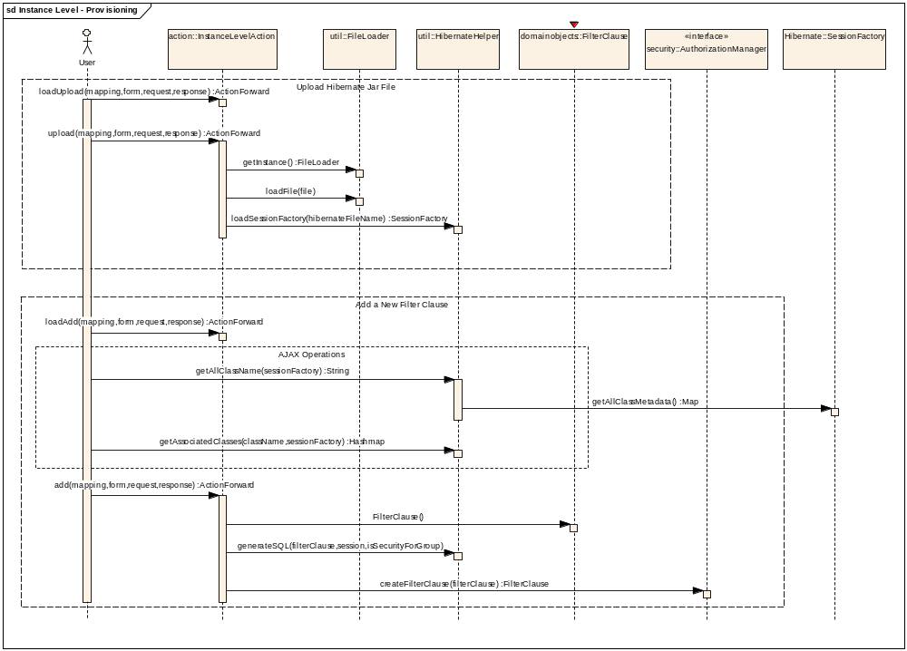

Slide 6
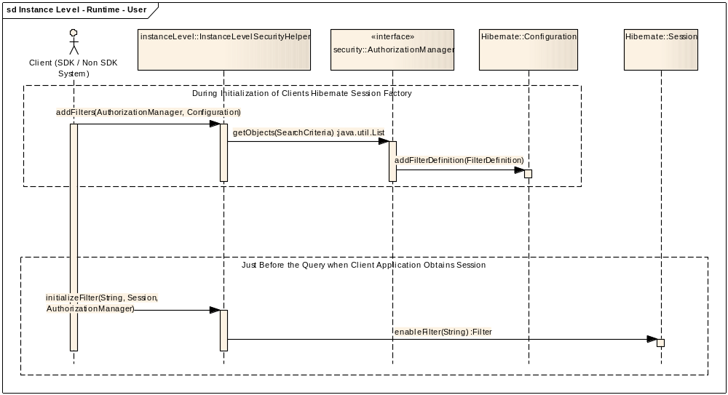
Instance Level Security for User

Slide 7
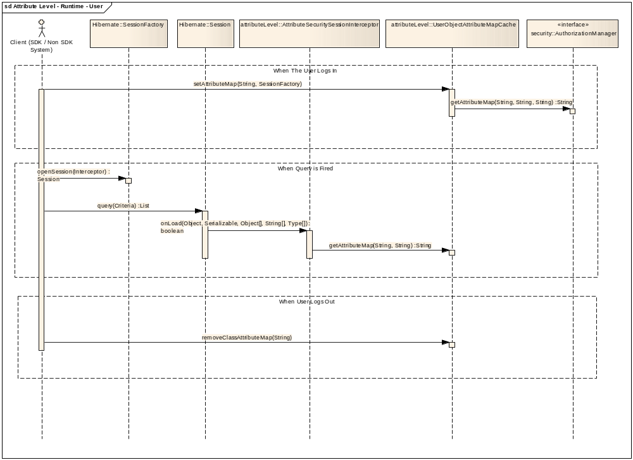
Attribute Level Security For User

Slide 8
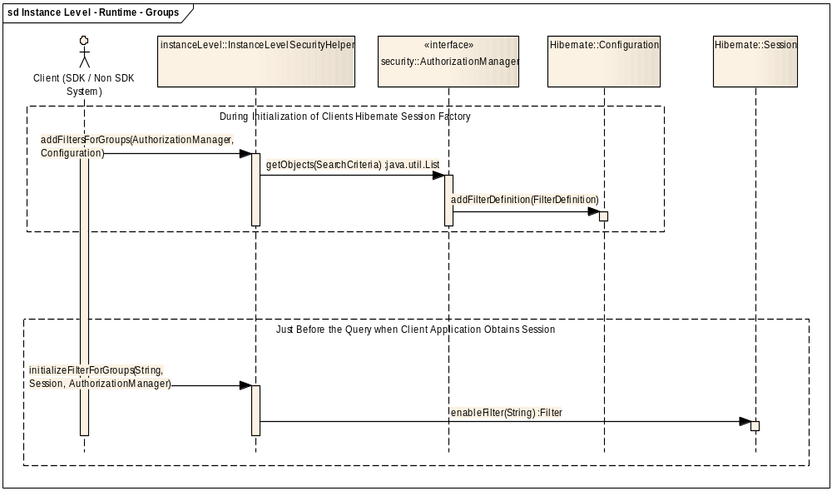
Instance Level Security For Groups

Slide 9
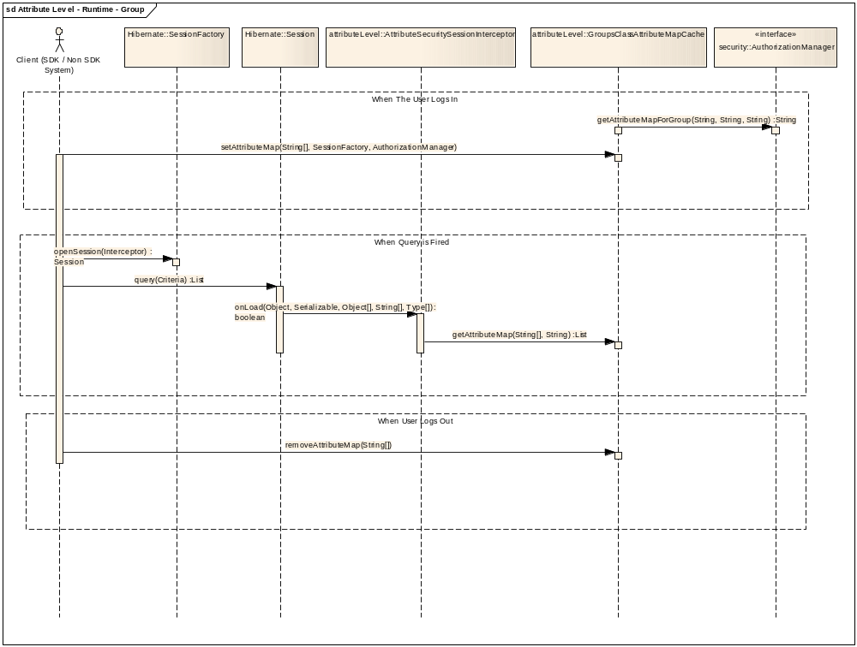
Attribute Level Security For Groups

Slide 10
[GF#9290] Support Hibernate Annotations
Hibernate annotations link
Hibernate Core Requirements
  Requires Hibernate Core 3.2.x
New Libraries
  hibernate-annotations.jar
  hibernate-comons-annotations.jar
UPT Source Code Changes
  HibernateHelper.loadSessionFactory()
  sessionFactory = new AnnotationConfiguration() configure().buildSessionFactory();
Risks
  None

Slide 11
[#12231] MySQL subselect performance
Improve MySQL Subselect Query performance.
With the help of DBA optimize MySQL Sub Select Query performance on Instance Level security queries.

